Slide 1
Yoga at work
Prepared by
Dian Prudentia #PruYoga
E : dian.prudentia@gmail.com
P : +62812 818 4595
https://www.linkedin.com/in/dianprudentia

Slide 2
Introduction
Namaste….
Dian has been doing yoga since 2011, when she practiced at the gym. She was 60 kilos, having lower back pain, menstruation illness, monthly fever and flu illness. Until she realized that she needs changed for her healthiness.
She did yoga once a week, she felt her body becomes better. Slowly, she has lost the lower back pain, flu has gone significantly. So she becomes intense for practicing yoga.
Started in January 2013, she joined Purninawa Yoga Teacher Training 50 hours, joined Bliss Teacher Tranining for Yoga Therapy in August 2013. She also followed several workshops for yoga therapy.
Named as PRUYoga means a hard worker with gentle heart. Same as Yoga, every movement must be energized and smooth.

Slide 3
The benefit of yoga
Yoga is (Sanskrit, from the root ‘Yuj’) Union , to join, to unite between ourselves and universe (God, creator). Yoga combines the breathe, the movement and the mind. It’s also called as the movement meditation.
Yoga taught us to be present as we know the key of happiness is be present. By flowing the movement, yoga will reduce the tensions on muscles, make the bone gets strong, it will move from up and down our body parts. By flowing the breath, it will helps us to release the tensions on mind and improve the blood circulation. By focusing the mind, we are more grateful by being the present and less of stress. Some yoga poses will reduce lower - upper back pain, neck pain, constipations and body stiffness.
Yoga is more than regular exercise, our body more flexible, more strong, our mind will be calm

Slide 4
clients
Private
Couple; Claudia Mayasari (Sr. Manager at Gudang Garam) and Armando Sialagan (Marketing Manager at PT Kapal Api Global), Irene Nancy (IT Consultant) and Ferdi (Purchasing Manager at BP)
Single; Dian Ramadiyanti (Senior Brand Manager at Mondelez), Marini Sulaeman (Managing Partner at Legisperitus Lawyer), Daniel Ziv (Writer, Movie producer), Francesco Holmes (Executive Chef at JW Marriot), Karina (Dentist), Cindy (Headhunter), Shirley (NGO), Mira (NGO), Ms. Lily (a housewife), Davina (Senior TMM at KAO), Monica (SBM at Martha Tilaar).
Family : Mrs. Agnes Amelia (GM Sales&Marketing at NYX cosmetic) and Mr. Ruby (Banker at Permata Bank) with family
Office / Group / Studio
PT Solusindo Tunas Pratama, Tbk, on behalf of Maximum Martial arts
Sasikirana Spa and Yoga Studio
POISE Pilates and Yoga
NYX Cosmetic (as per March)
Dian has been participated on AXA Yoga in the City (2013), Volunteer at Yoga Gembira, founded by Yudhi Widiantoro, volunteer for prenatal yoga with Nirasha Darusman and supported yoga for kids on Miniapolis Anniversary

Slide 5
Services of PruYoga
PRUYoga will introduce Hatha Yoga, means sun and moon. Flowing the movement with breathing and mindful. She will observe the member before the class is started, such as, basic flow is dedicated for beginner member. The session is for an hour, including relaxations. Music is prepared by PRUYoga (could be also with speaker)
Replacement teacher will be provided by PRUYoga
Fee / donation will be discussed separately
Yoga props and yoga mat will be provided by clients.

Slide 6
SCHEDULE
Time /day | MON | TUE | WED | TUES | FRI | SAT | SUN
7-8 AM |  |  |  |  |  | Booked
8-9 AM |  |  |  |  | Self practice | Booked
9-10 AM | Self practice (tentative) |  | Self practice (tentative)
10-11 AM | Self practice (tentative) |  | Self practice (tentative) |  |  | Booked | Booked
11 -12 PM
12-1 PM
1 -2 PM
2 -3 PM
3 -4 PM |  |  |  |  |  |  | Booked
4 -5 PM
5 -6 PM |  |  |  |  |  |  | Booked
6 -7 PM | Booked | Booked | Booked | Self practice
7 -8 PM

Slide 7
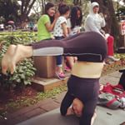
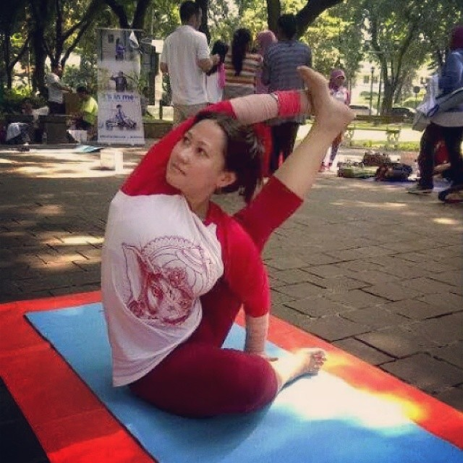
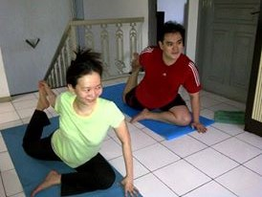
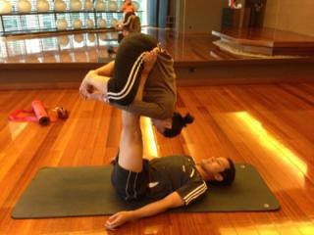
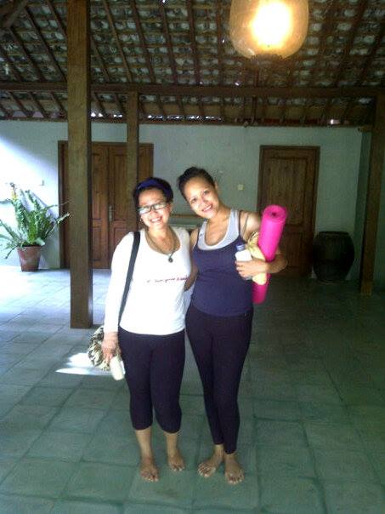
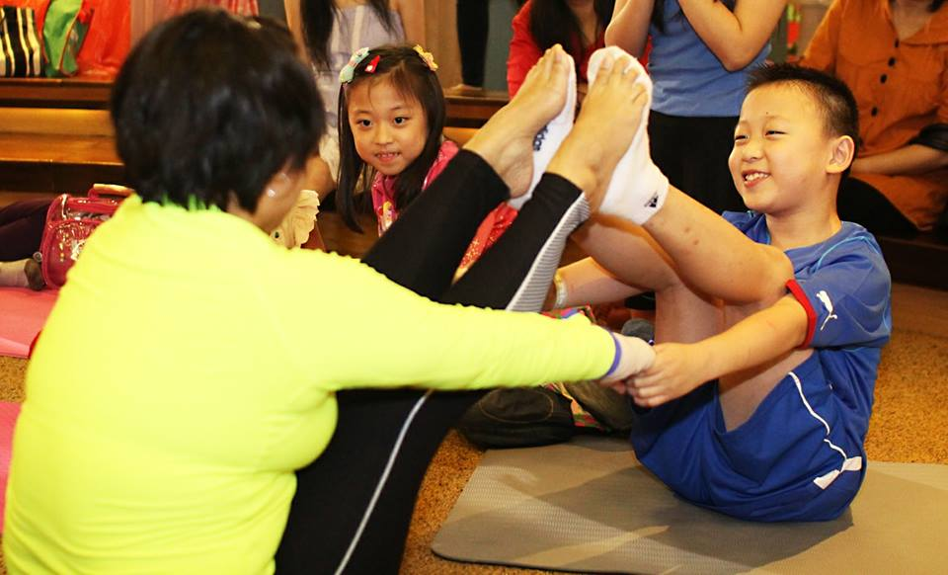
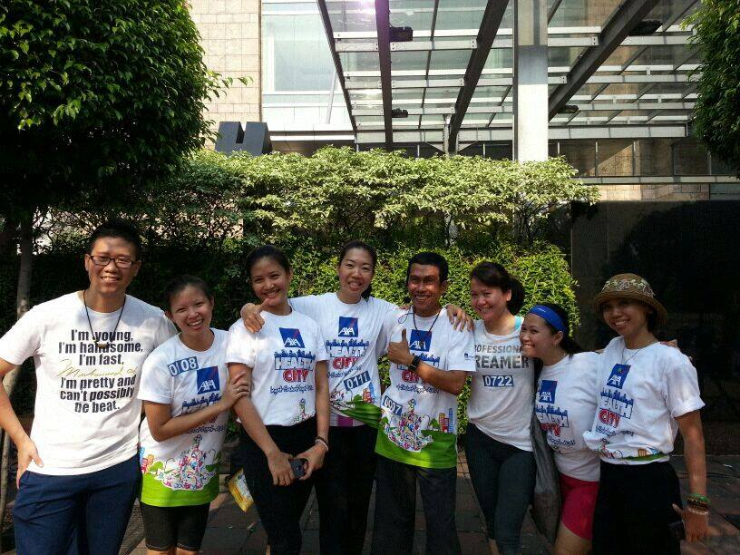
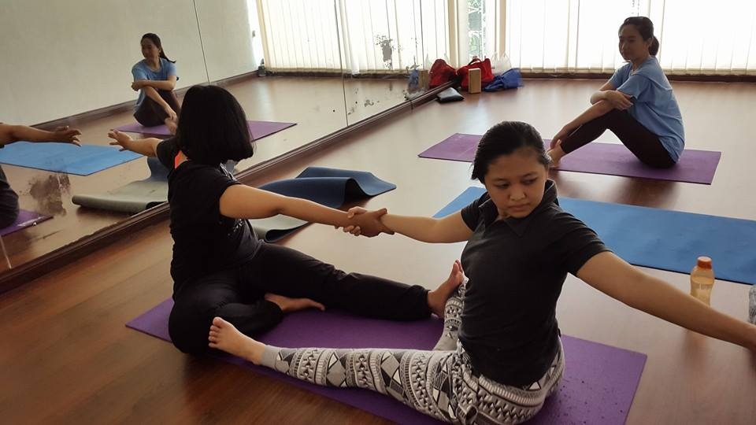
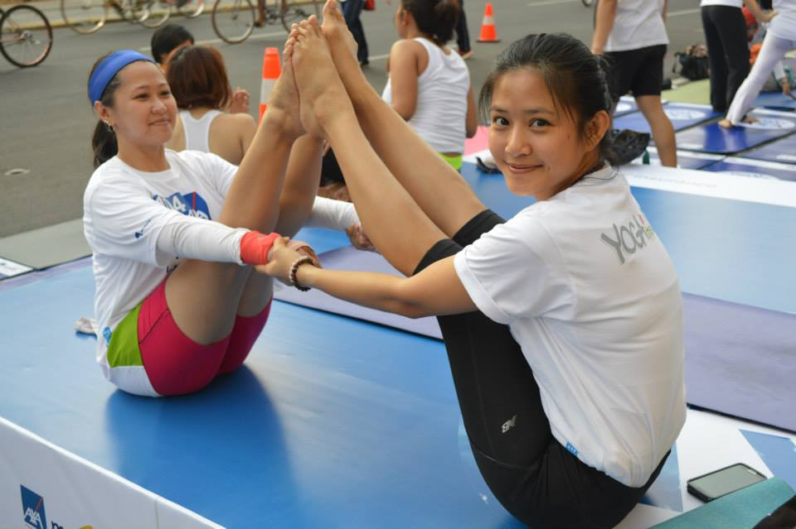
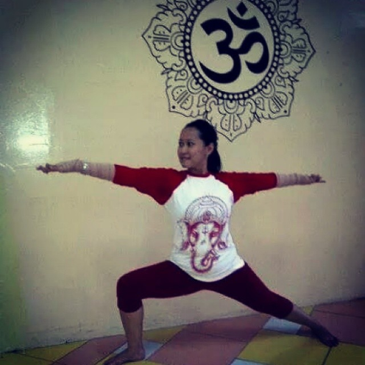
Pictures

Slide 8
THANK YOU
May you all beings be happy…
May you all beings be free from suffering…
Sat nam.. Sat nam.. Sadhu .. Sadhu..
NAMASTE

